Slide 1
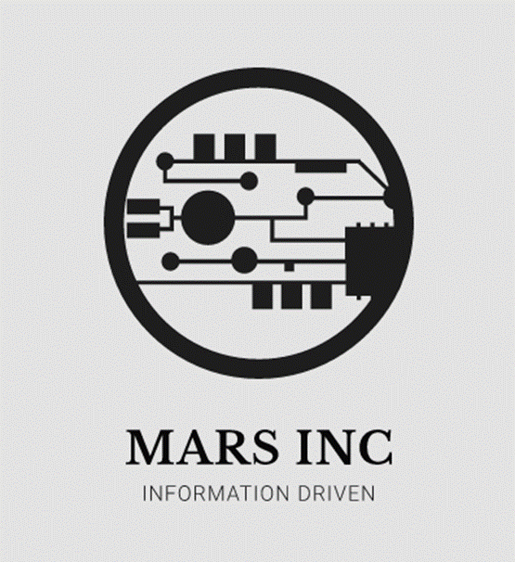
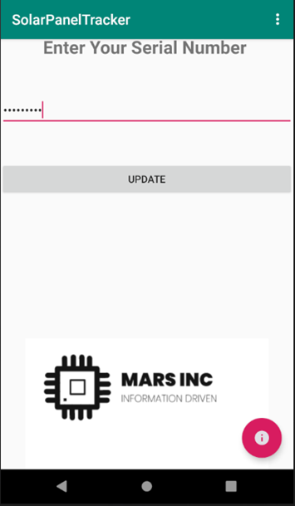
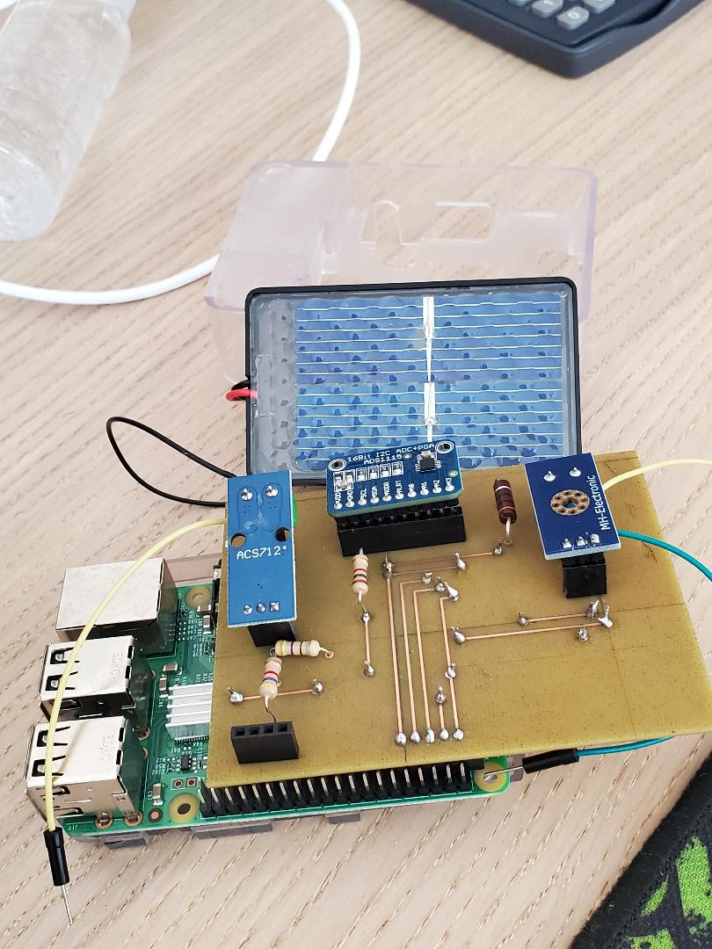
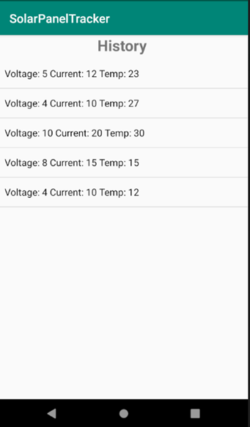
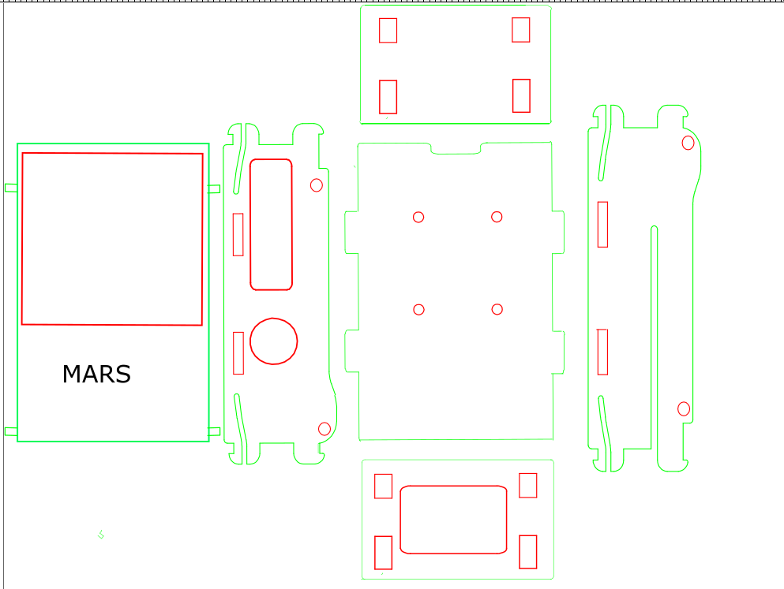
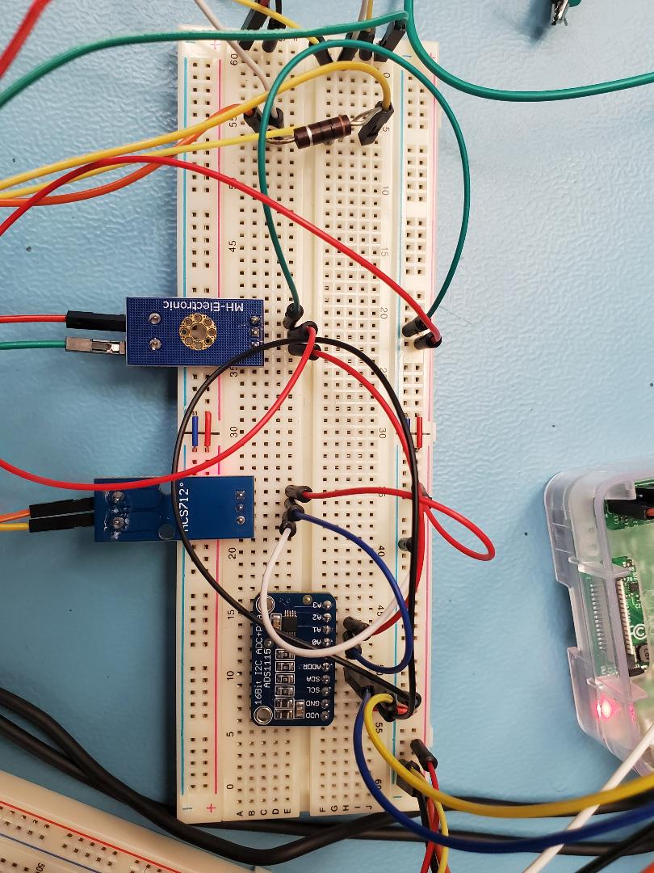
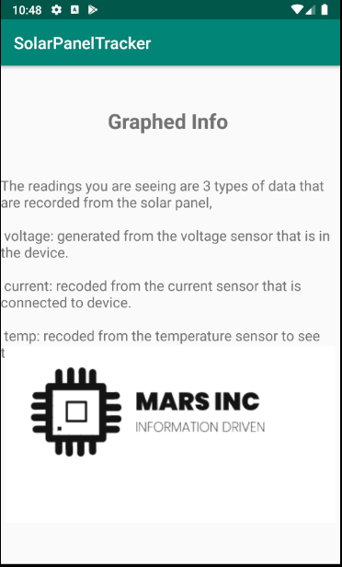
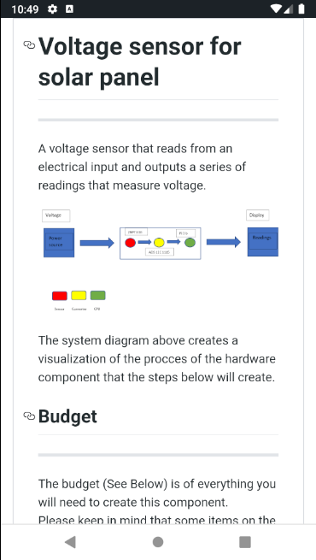
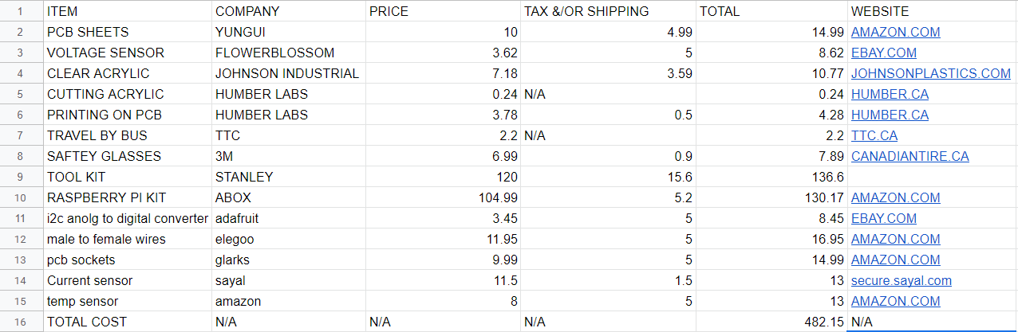
Solar Panel Monitoring System
Ahmad El-Hajj, Ramin Kurkeice, Matthew Phillip Department of Computer Engineering Technology, College of Humber North
INTRODUCTION
Mars is a small organization of students that are taking on this capstone project for Humber college institute of advanced learning and technology on the Solar panel monitoring of the solar panels on the gazebo. We are omitting the website application as we believe that the mobile application is more compact easy to access and can be ported to a website in the future. We are including a Lumosity sensor as well as a current and voltage sensor to calculate power and lux of the solar panel. We also are making a database that collects this information and adds it to the mobile application. We undertook this assignment as a way to help improve our skills and inspire companies to maintain solar panels. The problems we have are Humber is unable to access the database of the solar panels from the original installers and we must make one from scratch.
MATERIAL AND METHOD
Our methodology of the Solar panel senor for Humber institute of technology and advanced learning was to use the agile method for our project management we created Gantt charts for both the software and hardware components
Materials used:
ACS 712 Current Sensor
ZMPT101B Voltage Sensor
DS18B20 Temperature Sensor
Raspberry pi 3 B
ADS1115 Analog to Digital Converter (ADC)
Velleman Solar Panel
Resistors : 1k ohms, 470 ohms and 4.7k ohms
Custom case and PCB
Tools and Facilities:
Android Studio
Python 3
Firebase database
Wire strippers
Safety glasses
Fritzing
Humber Prototype Lab
Cura
Inkscape
DATABASE
The database was created through firebase and connected through the android studio with the database function that tests the serial number from the input and when clicking the update button, the code will authenticate the serial number and then pull from the records to an array list to post onto a list view that displays the current, voltage, and temperature from the database that is given from the raspberry pi readings that is pushed to it.
Access:
1 Open Application
2 Write serial number of the device
3 Access the data through a list view
4 Info page on bottom right
5 Set up page on top right
CONCLUSIONS
The Solar Panel monitoring system is functioning the way its supposed to. Voltage, current and temperature values are able to be monitored on a custom PCB. Values are able to be uploaded to the database. Mobile app is functioning and able to fetch the information from firebase and display the values. The prototype doesn’t have an enclosure at the moment as the prototype lab closed due to recent events. The custom PCB tends to have issues sometimes this could be the result of pins not fully covered in solder or some sort of damage , but it does function majority of the time.
The Goal of completing this capstone project is to make a functioning device that take the input of the power coming from the solar panel and recording the data. We hope that this information will provide useful examples of how much energy is pulled from an ecofriendly source and may push other organizations, companies, and businesses to go solar in the near future.
Figure 2.0 – Main SRN page, page to find the registered device in the database.
Figure 1.0 - Picture of the designed device.
Figure 1.1 – Inkscape case design.
REQUIREMENTS
The Solar Panel monitoring system collect data at a consistent time . Data must be measured from the sensors such as voltage and current sensors. Temperature sensor will also be required to determine the weather of the day. Once data is measured on a raspberry pi it must be uploaded to the server and display it on a mobile device
1) Monitor Solar panel data from the sensors
2) Data is displayed on mobile app
Figure 2.1 – History page,
Page that displayed the data from the database in a listview
Figure 1.2 – Prototype this is the Breadboard wiring of the solar panel tracker that feeds in from the solar panel and run into both current and voltage sensor for readings. .
ACKNOWLEDGEMENTS
We would like to thank Kristian Medri and Dragos Parachiv for their guidance in the project.
We would also like to thank Humber College for providing the facilities and resources necessary to the completion of the capstone.
Figure 1.3 – budget of the total parts and equipment for the design of the solar panel project
Figures 2.2 (Left) – 2.3 (Right) – info (Left) and setup page (Right), the info page is displayed for understanding readings from the database, and the set up page is to help build the device in the GitHub and how it works.

